Slide 1
SALES
INSIGHTS

Slide 2
SALES
INSIGHTS
1
Understanding Business Problem / AIMS Grid
2
Data Collection & Understanding
3
Data Transformation & Modelling
4
Power BI – Sales Revenue Analysis
5
Power BI – Sales Profit Analysis
6
Power BI – Sales Performance Analysis
7
Power BI - Sales Insights

Slide 3

1
Understanding Business Problem
AtliQ Hardware, a computer hardware and peripherals company with multiple branches across India, is facing several challenges:
Sales performance is declining gradually and not meeting expectations.
The sales director struggles to understand business performance and identify issues.
Regional managers often sugarcoat the truth and provide numerous Excel files instead of clear information.
The sales director experiences frustration due to the difficulty of consuming numbers from Excel files.
📊 Problem Statement
To address these challenges, the sales director of AtliQ Hardware decided to:
Develop a Power BI dashboard to convert data into visual representations.
Enable data-driven decision-making through clear and accessible visual data.
Hire a team of data professionals to build and implement the dashboard.
Solution
1

Slide 4
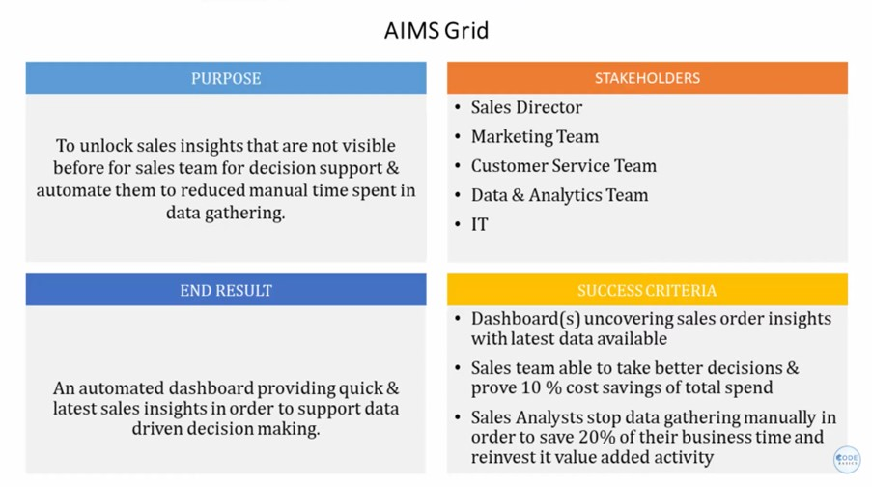
1
Understanding Business Problem with AIMS Grid
1

Slide 5
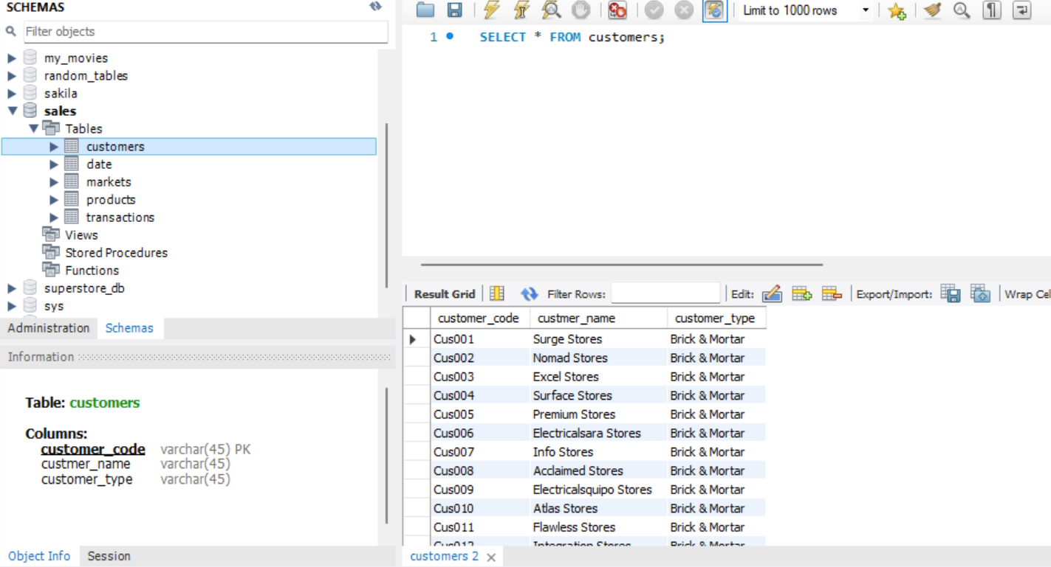
2
Data Collection & Understanding
Data Analysis Using SQL
1. Show all customer records
2

Slide 6
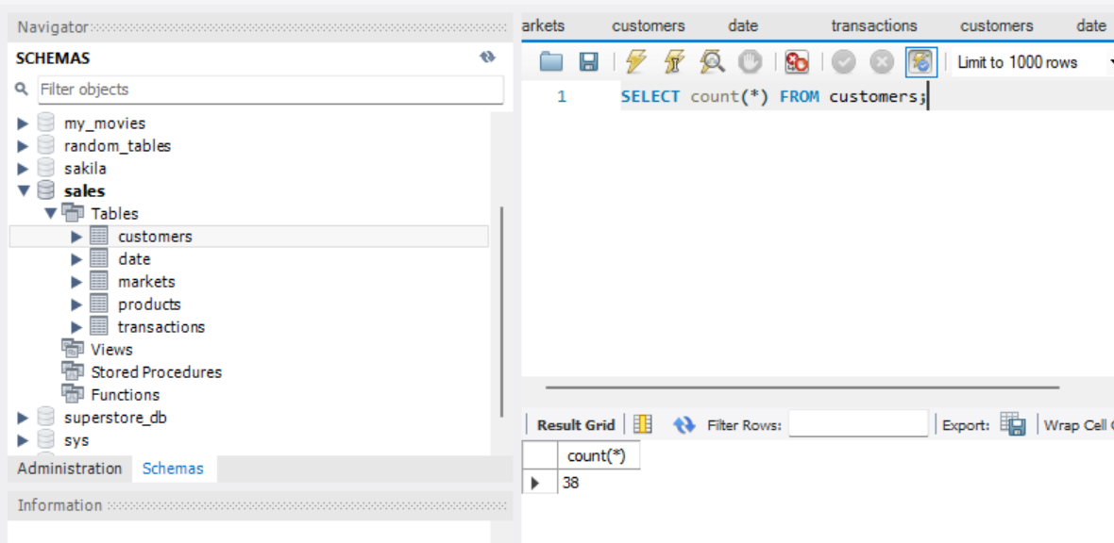
2
Data Collection & Understanding
Data Analysis Using SQL
2. Show total number of customers
2

Slide 7
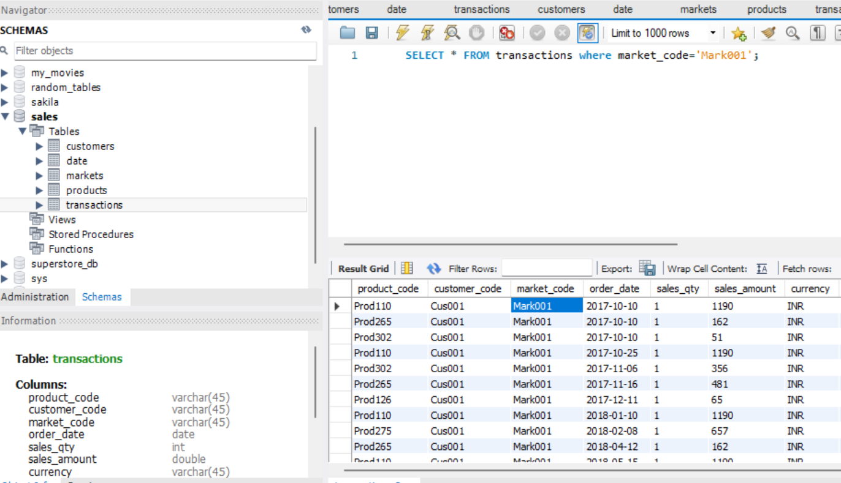
2
Data Collection & Understanding
Data Analysis Using SQL
3. Show transactions for Chennai market (market code for Chennai is Mark001)
2

Slide 8
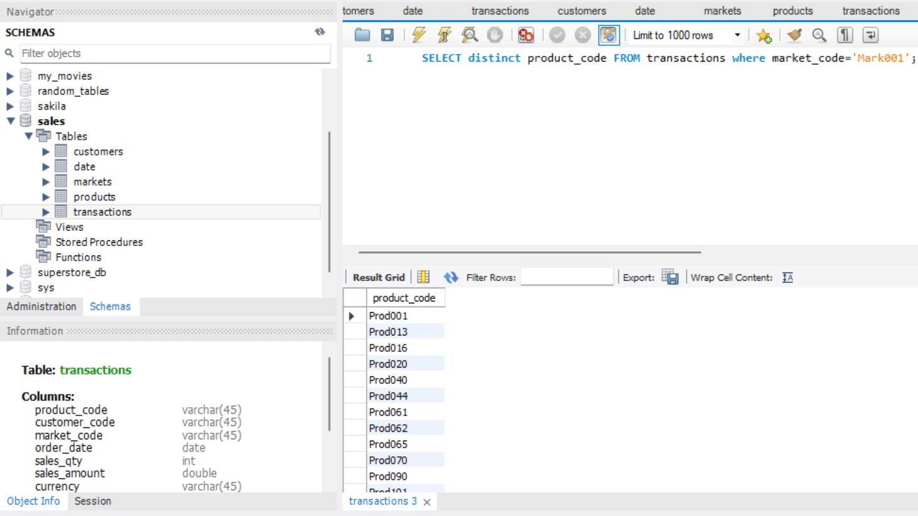
2
Data Collection & Understanding
Data Analysis Using SQL
4. Show distinct product codes that were sold in Chennai
2

Slide 9
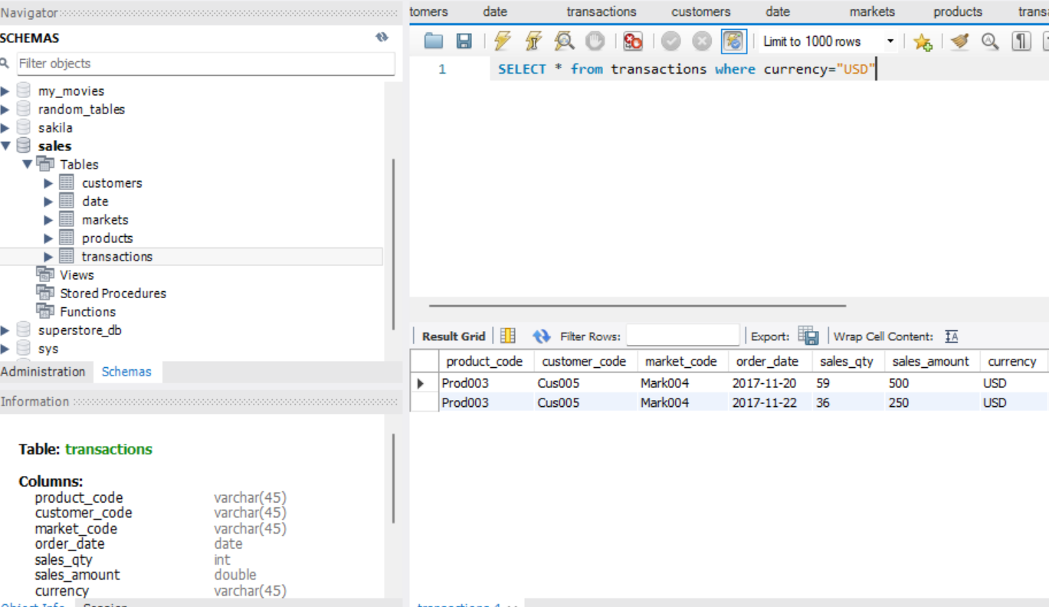
2
Data Collection & Understanding
Data Analysis Using SQL
5. Show transactions where currency is US dollars
2

Slide 10
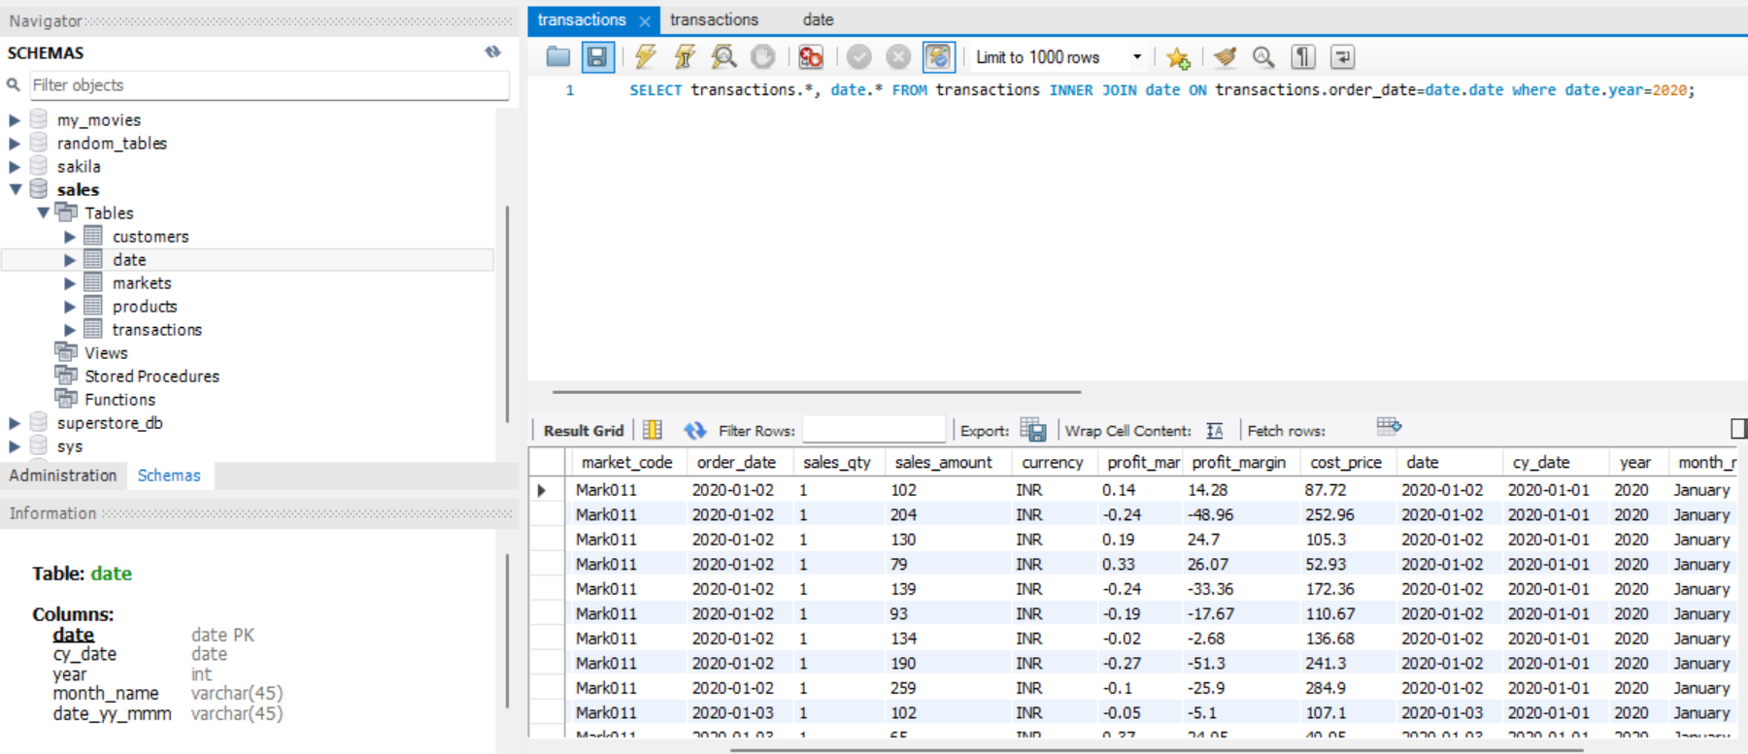
2
Data Collection & Understanding
Data Analysis Using SQL
6. Show transactions in 2020 join by date table with transactions table
2

Slide 11
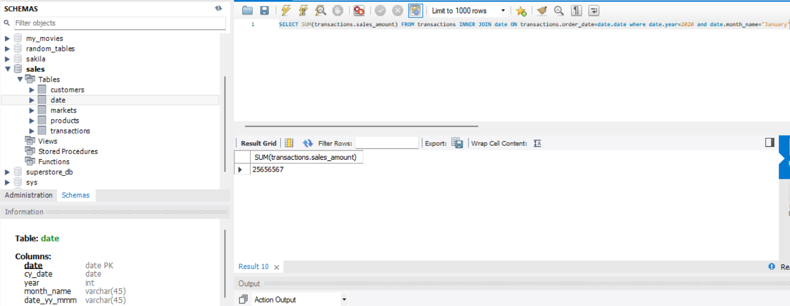
2
Data Collection & Understanding
Data Analysis Using SQL
7. Show total revenue in year 2020, January Month
2

Slide 12
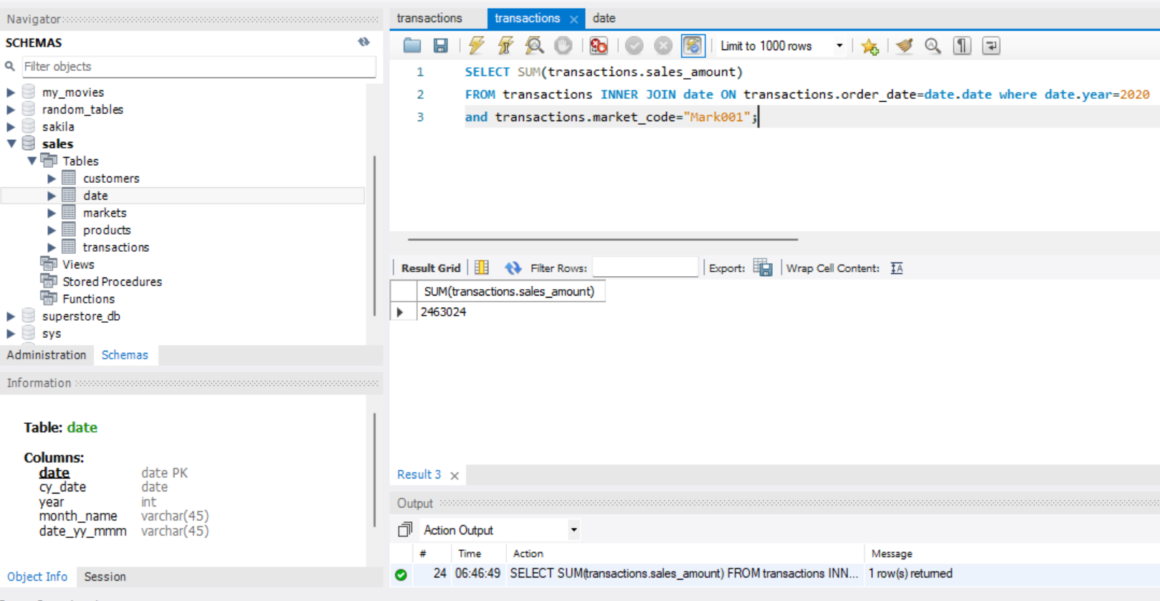
2
Data Collection & Understanding
Data Analysis Using SQL
8. Show total revenue in year 2020 in Chennai
2

Slide 13
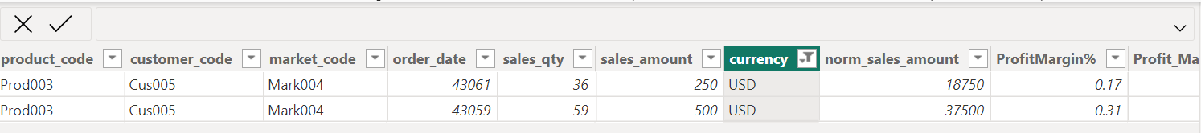
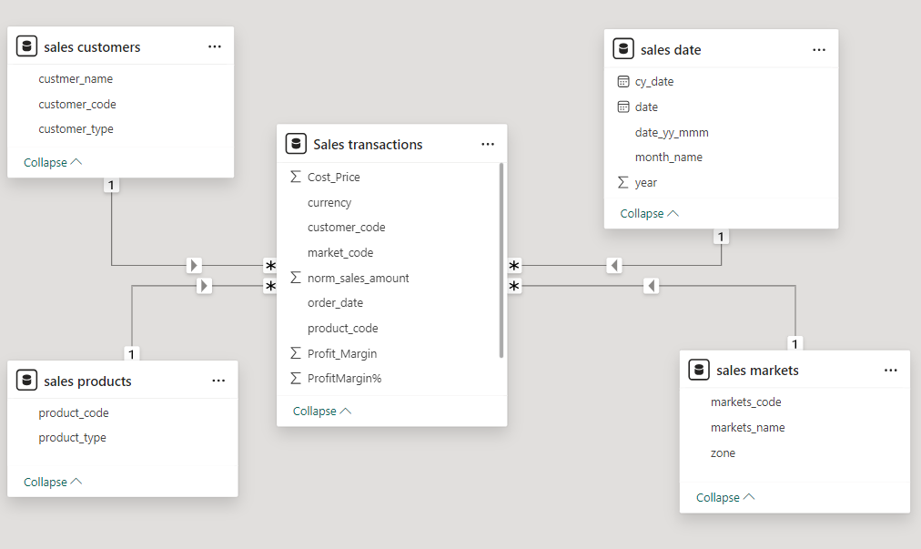
3
Data Transformation & Modelling
Normalizing the currency to INR
Star Schema Data Modelling
3

Slide 14
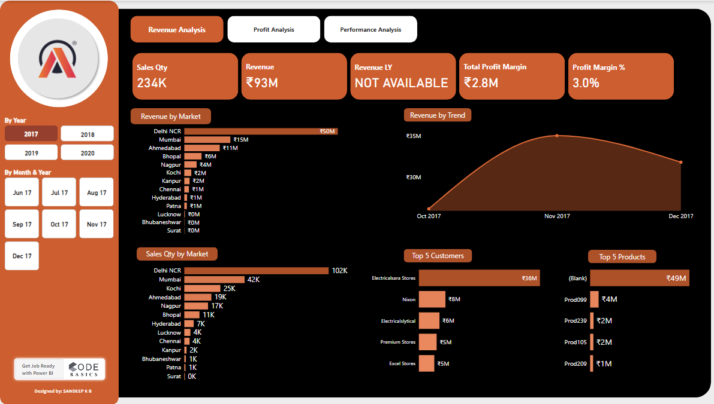
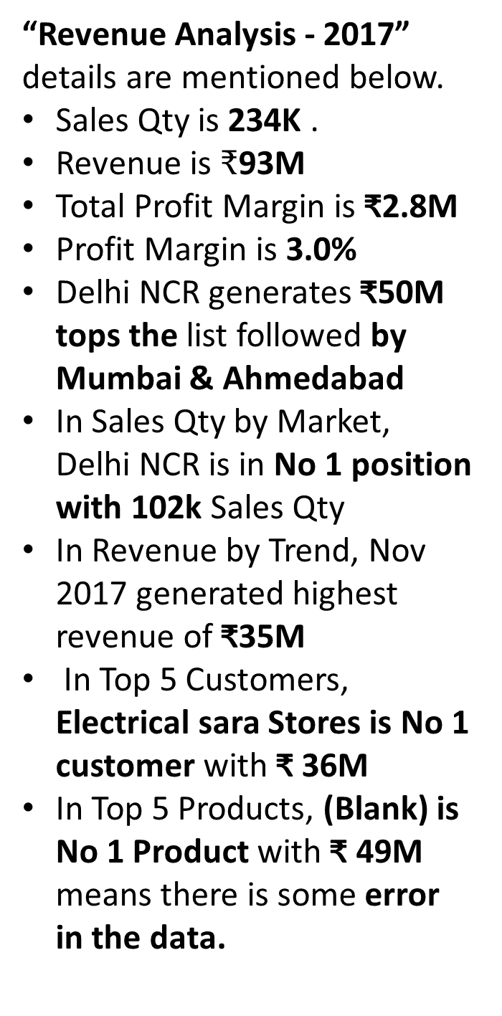
4
Power BI – Sales Revenue Analysis
Revenue Analysis – Year 2017
“Revenue Analysis - 2017” details are mentioned below.
Sales Qty is 234K .
Revenue is $₹$93M
Total Profit Margin is ₹2.8M
Profit Margin is 3.0%
Delhi NCR generates ₹50M tops the list followed by Mumbai & Ahmedabad
In Sales Qty by Market, Delhi NCR is in No 1 position with 102k Sales Qty
In Revenue by Trend, Nov 2017 generated highest revenue of ₹35M
In Top 5 Customers, Electrical sara Stores is No 1 customer with ₹ 36M
In Top 5 Products, (Blank) is No 1 Product with ₹ 49M means there is some error in the data.
4

Slide 15
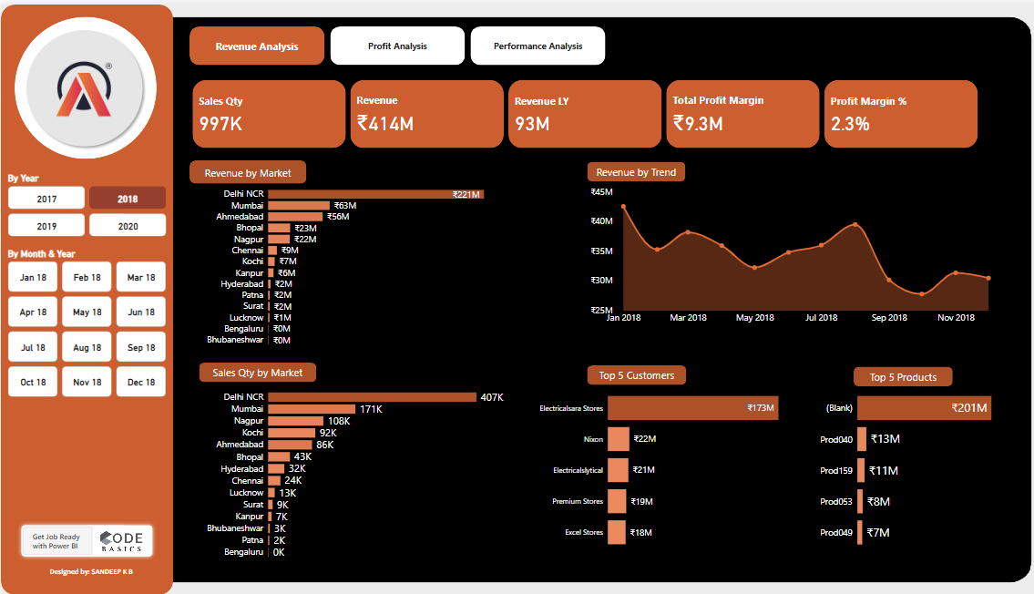
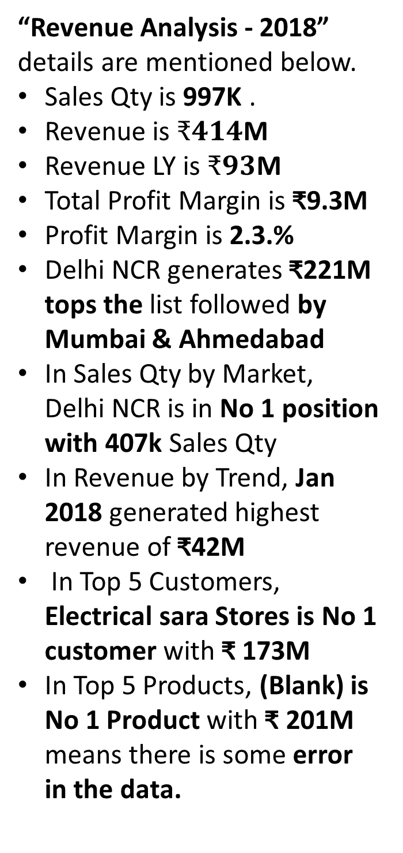
4
Power BI – Sales Revenue Analysis
Revenue Analysis – Year 2018
“Revenue Analysis - 2018” details are mentioned below.
Sales Qty is 997K .
Revenue is $₹414$M
Revenue LY is $₹93$M
Total Profit Margin is ₹9.3M
Profit Margin is 2.3.%
Delhi NCR generates ₹221M tops the list followed by Mumbai & Ahmedabad
In Sales Qty by Market, Delhi NCR is in No 1 position with 407k Sales Qty
In Revenue by Trend, Jan 2018 generated highest revenue of ₹42M
In Top 5 Customers, Electrical sara Stores is No 1 customer with ₹ 173M
In Top 5 Products, (Blank) is No 1 Product with ₹ 201M means there is some error in the data.
4

Slide 16
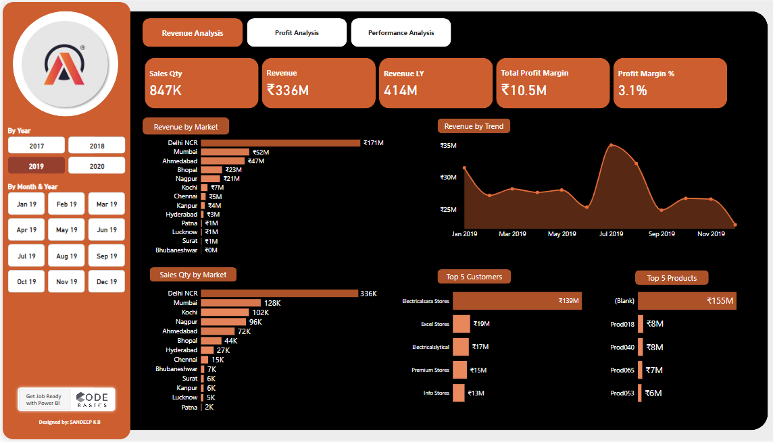
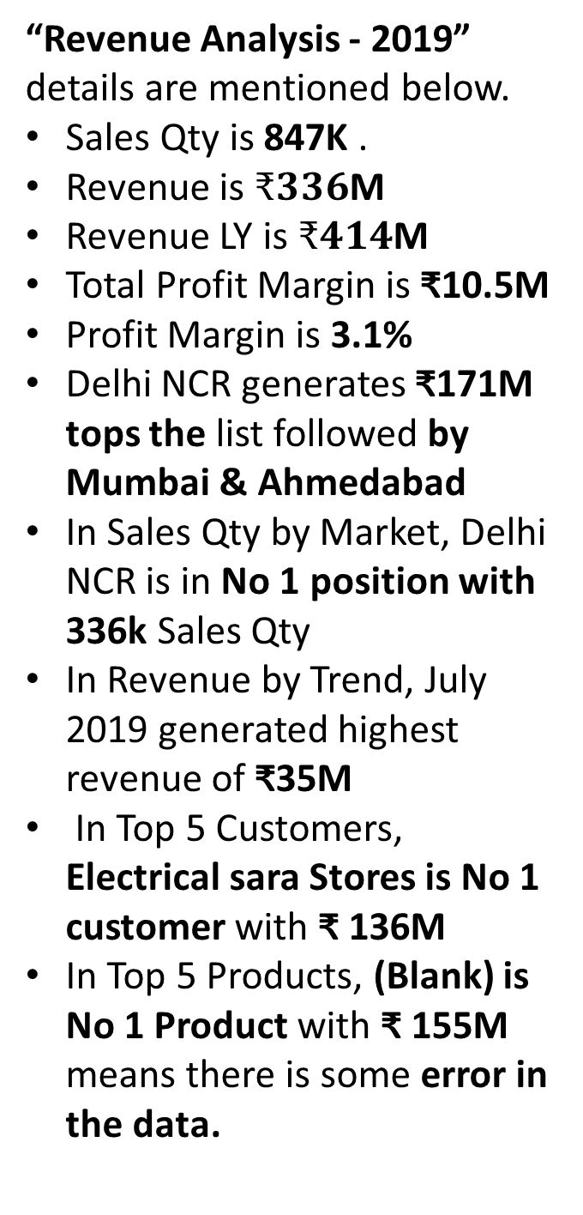
4
Power BI – Sales Revenue Analysis
Revenue Analysis – Year 2019
“Revenue Analysis - 2019” details are mentioned below.
Sales Qty is 847K .
Revenue is $₹336$M
Revenue LY is $₹414$M
Total Profit Margin is ₹10.5M
Profit Margin is 3.1%
Delhi NCR generates ₹171M tops the list followed by Mumbai & Ahmedabad
In Sales Qty by Market, Delhi NCR is in No 1 position with 336k Sales Qty
In Revenue by Trend, July 2019 generated highest revenue of ₹35M
In Top 5 Customers, Electrical sara Stores is No 1 customer with ₹ 136M
In Top 5 Products, (Blank) is No 1 Product with ₹ 155M means there is some error in the data.
4

Slide 17
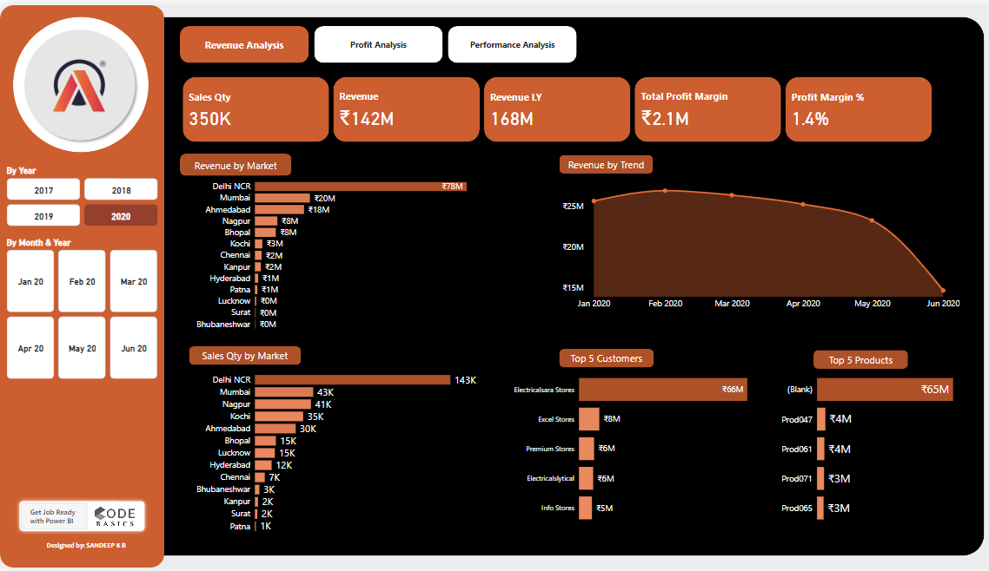
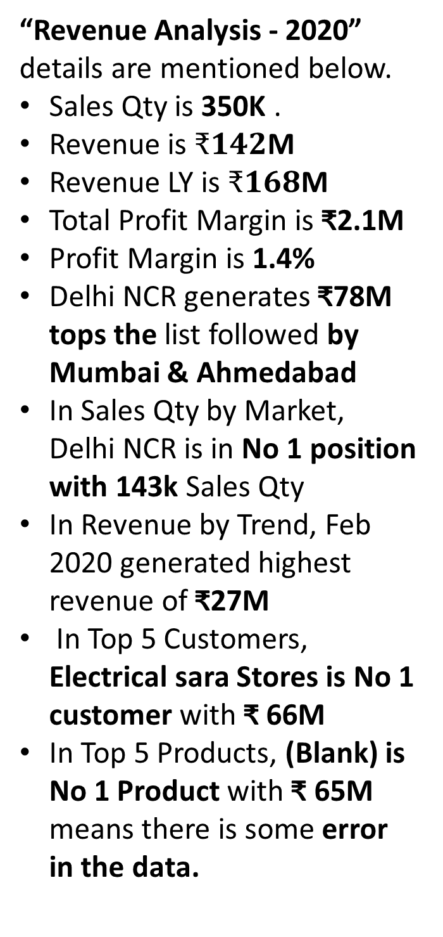
4
Power BI – Sales Revenue Analysis
Revenue Analysis – Year 2020
“Revenue Analysis - 2020” details are mentioned below.
Sales Qty is 350K .
Revenue is $₹142$M
Revenue LY is $₹168$M
Total Profit Margin is ₹2.1M
Profit Margin is 1.4%
Delhi NCR generates ₹78M tops the list followed by Mumbai & Ahmedabad
In Sales Qty by Market, Delhi NCR is in No 1 position with 143k Sales Qty
In Revenue by Trend, Feb 2020 generated highest revenue of ₹27M
In Top 5 Customers, Electrical sara Stores is No 1 customer with ₹ 66M
In Top 5 Products, (Blank) is No 1 Product with ₹ 65M means there is some error in the data.
4

Slide 18
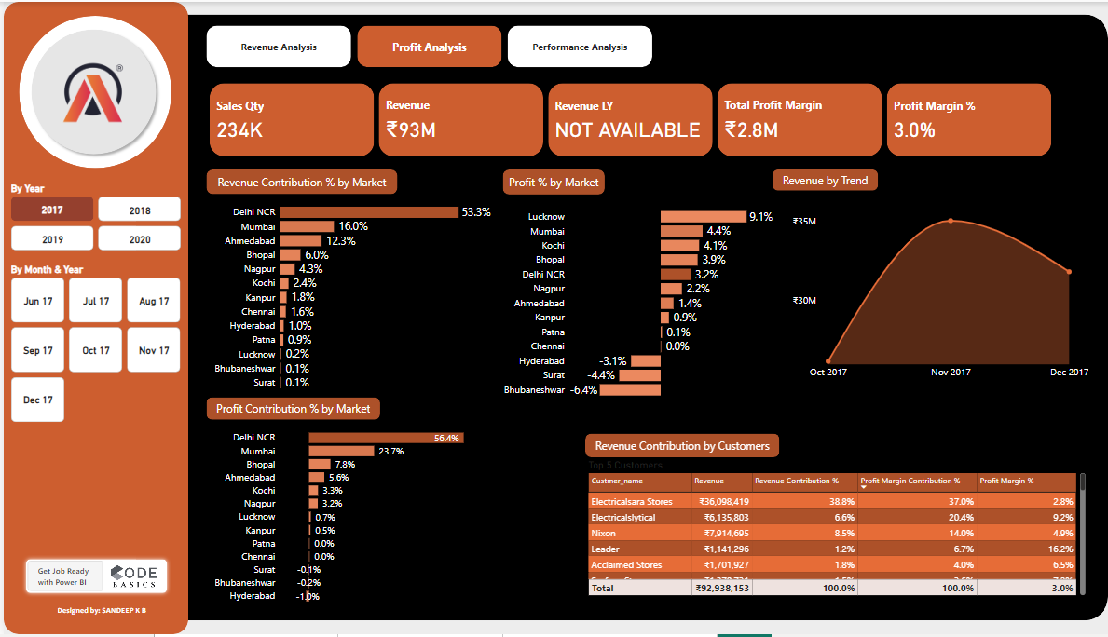
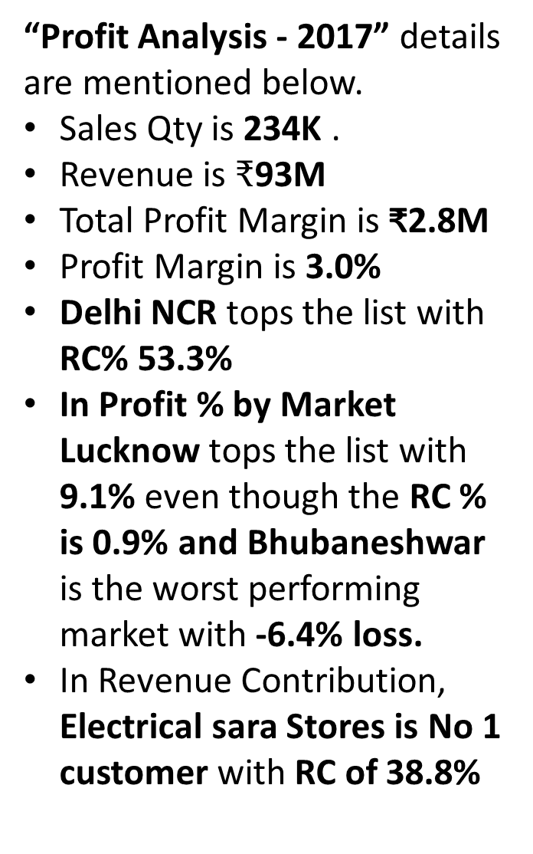
5
Power BI – Sales Profit Analysis
Profit Analysis – Year 2017
“Profit Analysis - 2017” details are mentioned below.
Sales Qty is 234K .
Revenue is $₹$93M
Total Profit Margin is ₹2.8M
Profit Margin is 3.0%
Delhi NCR tops the list with RC% 53.3%
In Profit % by Market Lucknow tops the list with 9.1% even though the RC % is 0.9% and Bhubaneshwar is the worst performing market with -6.4% loss.
In Revenue Contribution, Electrical sara Stores is No 1 customer with RC of 38.8%
5

Slide 19
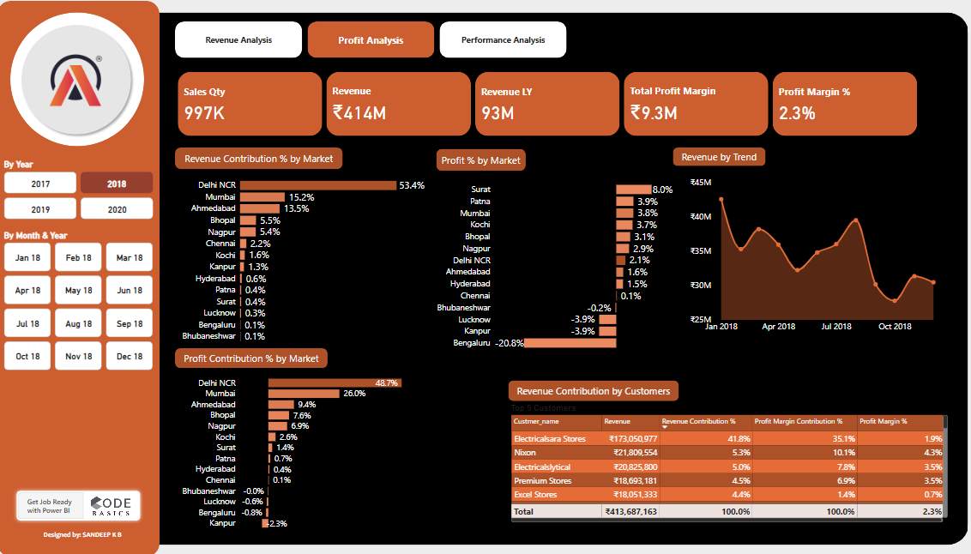
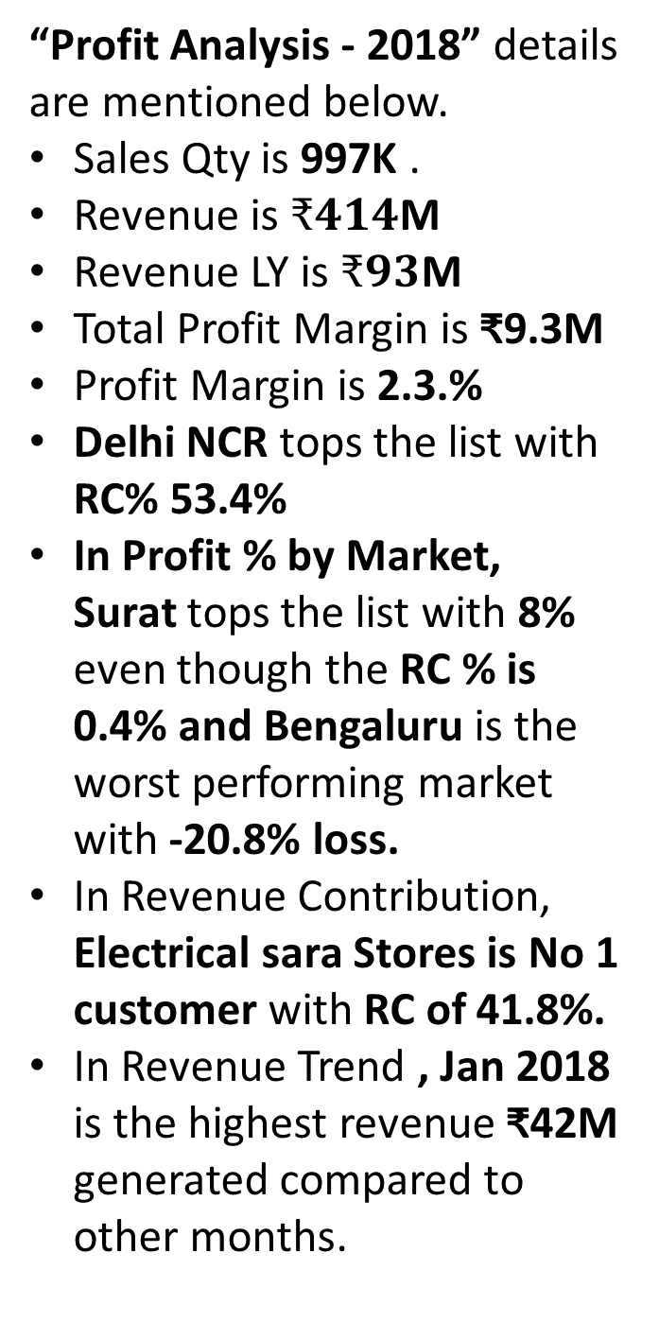
5
Power BI – Sales Profit Analysis
Profit Analysis – Year 2018
“Profit Analysis - 2018” details are mentioned below.
Sales Qty is 997K .
Revenue is $₹414$M
Revenue LY is $₹93$M
Total Profit Margin is ₹9.3M
Profit Margin is 2.3.%
Delhi NCR tops the list with RC% 53.4%
In Profit % by Market, Surat tops the list with 8% even though the RC % is 0.4% and Bengaluru is the worst performing market with -20.8% loss.
In Revenue Contribution, Electrical sara Stores is No 1 customer with RC of 41.8%.
In Revenue Trend , Jan 2018 is the highest revenue ₹42M generated compared to other months.
5

Slide 20
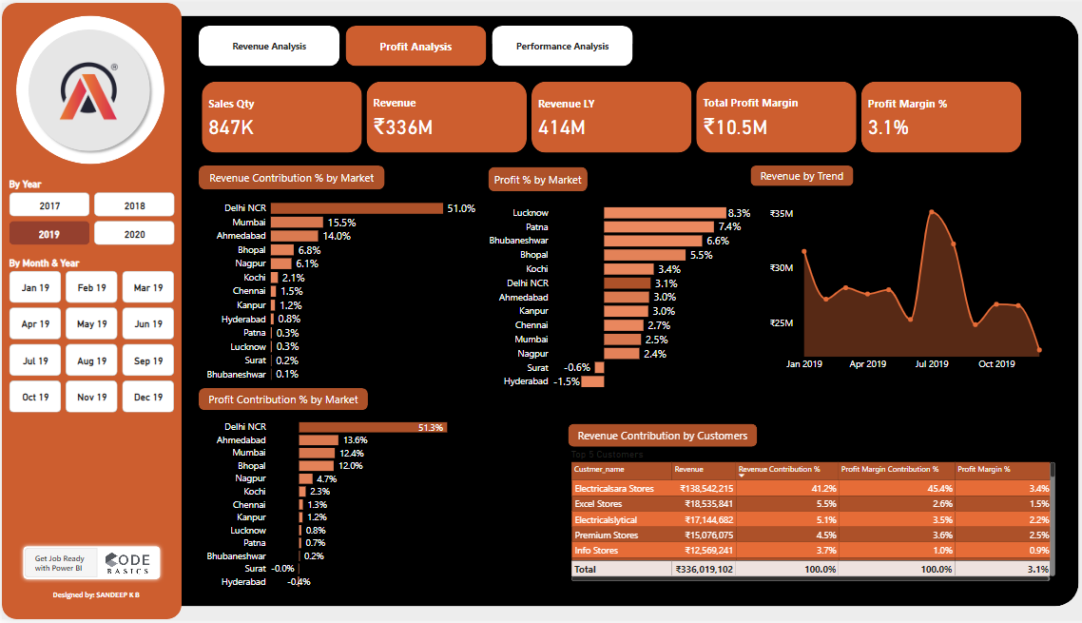
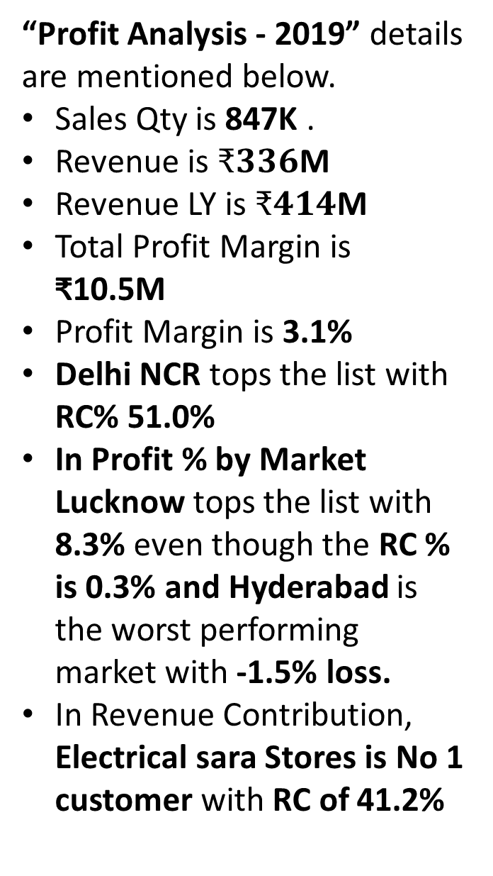
5
Power BI – Sales Profit Analysis
Profit Analysis – Year 2019
“Profit Analysis - 2019” details are mentioned below.
Sales Qty is 847K .
Revenue is $₹336$M
Revenue LY is $₹414$M
Total Profit Margin is ₹10.5M
Profit Margin is 3.1%
Delhi NCR tops the list with RC% 51.0%
In Profit % by Market Lucknow tops the list with 8.3% even though the RC % is 0.3% and Hyderabad is the worst performing market with -1.5% loss.
In Revenue Contribution, Electrical sara Stores is No 1 customer with RC of 41.2%
5

Slide 21
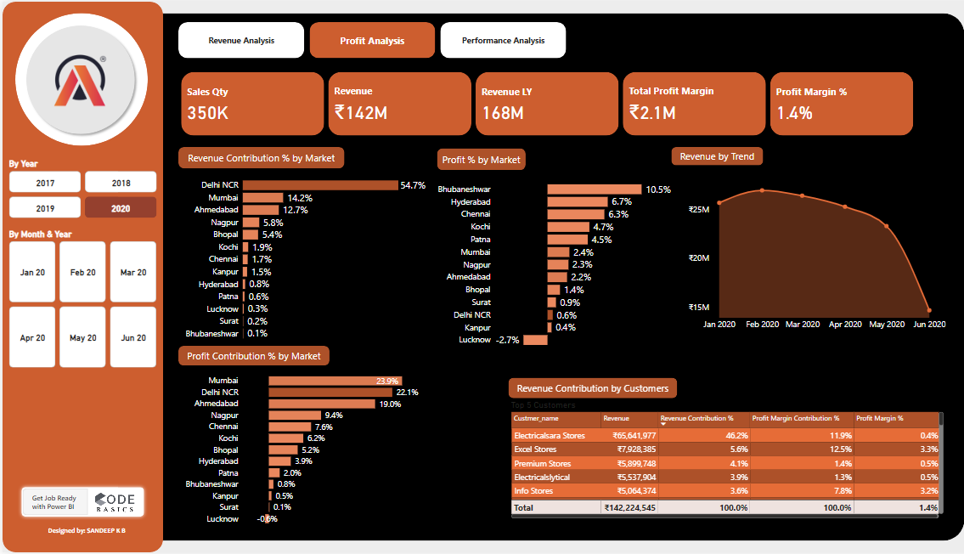
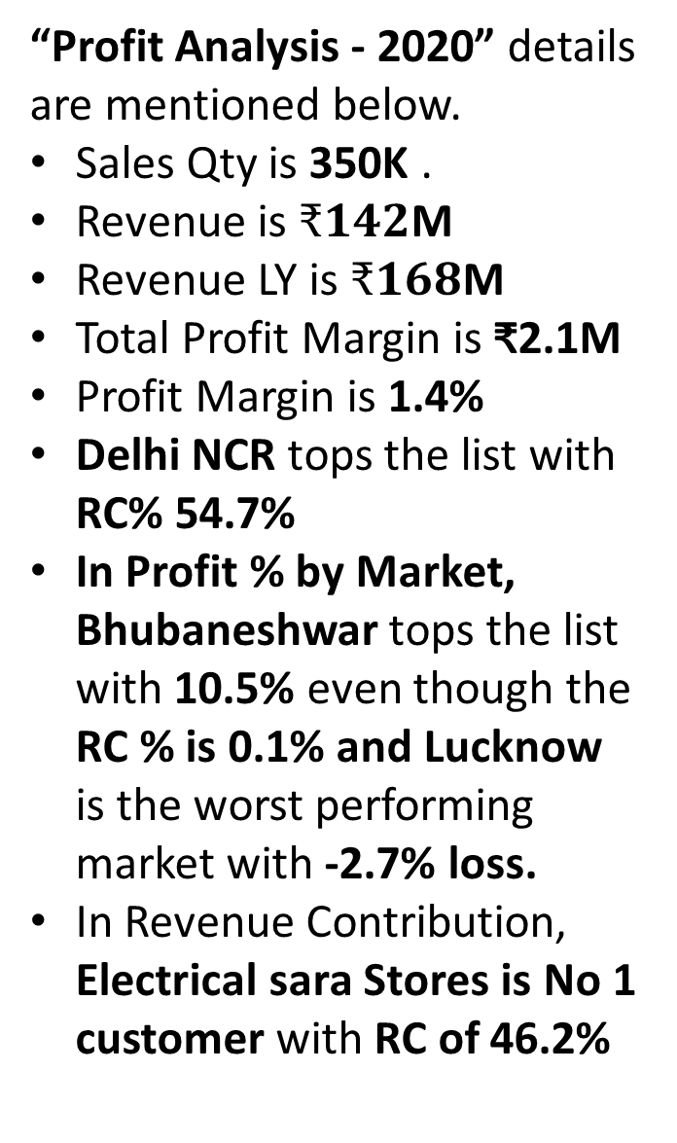
5
Power BI – Sales Profit Analysis
Profit Analysis – Year 2020
“Profit Analysis - 2020” details are mentioned below.
Sales Qty is 350K .
Revenue is $₹142$M
Revenue LY is $₹168$M
Total Profit Margin is ₹2.1M
Profit Margin is 1.4%
Delhi NCR tops the list with RC% 54.7%
In Profit % by Market, Bhubaneshwar tops the list with 10.5% even though the RC % is 0.1% and Lucknow is the worst performing market with -2.7% loss.
In Revenue Contribution, Electrical sara Stores is No 1 customer with RC of 46.2%
5

Slide 22
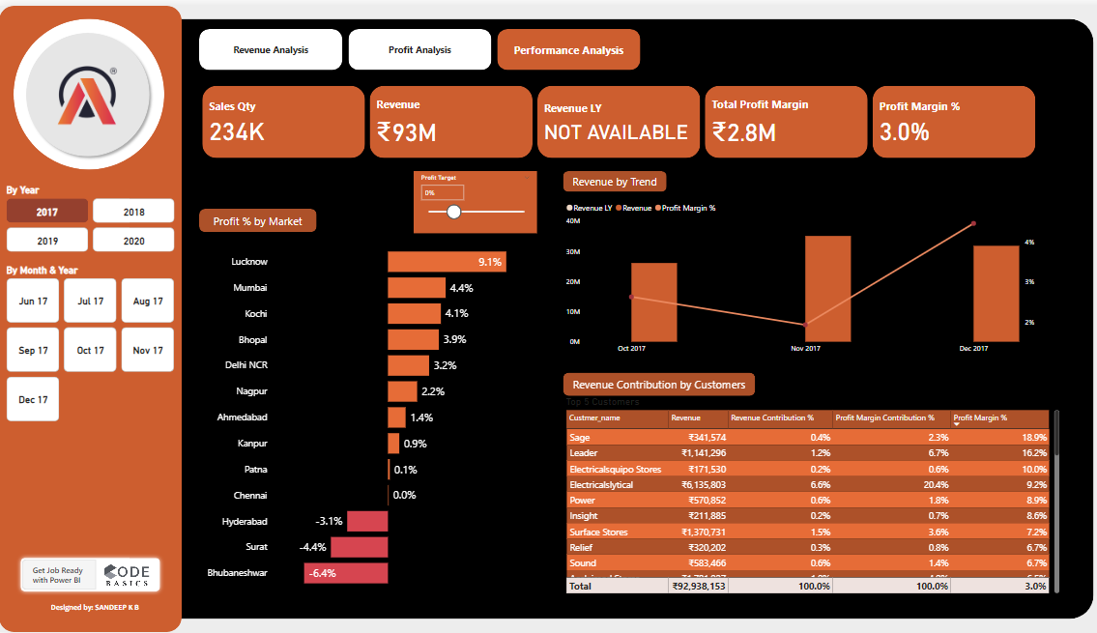
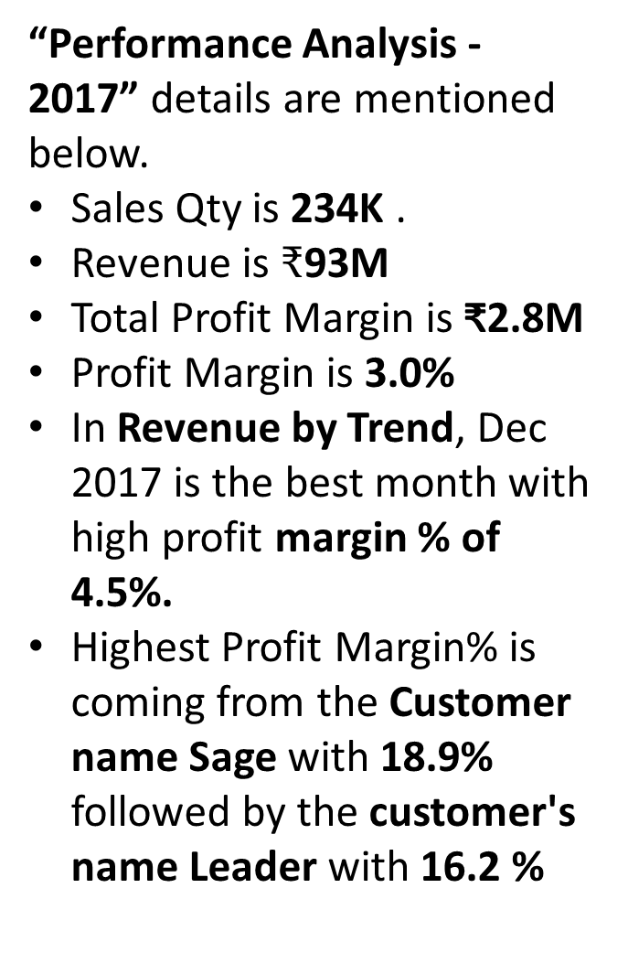
6
Power BI – Sales Performance Analysis
Performance Analysis – Year 2017
“Performance Analysis - 2017” details are mentioned below.
Sales Qty is 234K .
Revenue is $₹$93M
Total Profit Margin is ₹2.8M
Profit Margin is 3.0%
In Revenue by Trend, Dec 2017 is the best month with high profit margin % of 4.5%.
Highest Profit Margin% is coming from the Customer name Sage with 18.9% followed by the customer's name Leader with 16.2 %
6

Slide 23
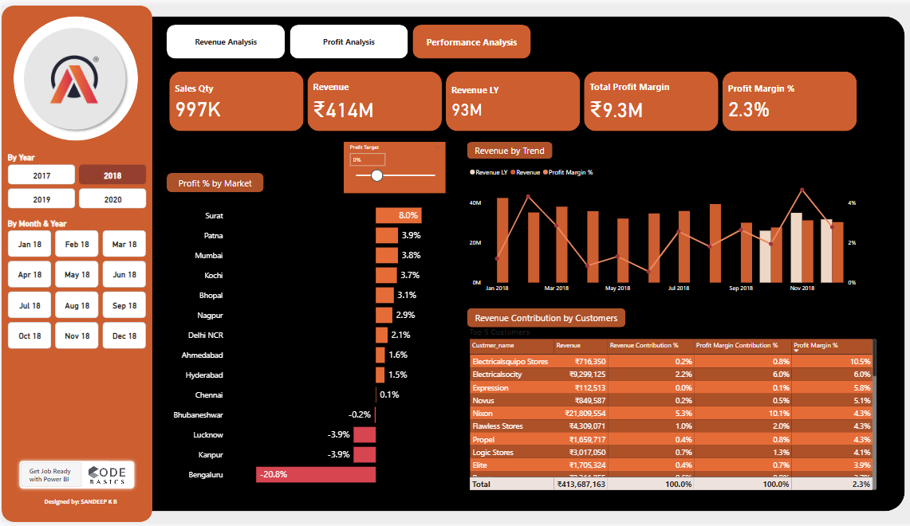
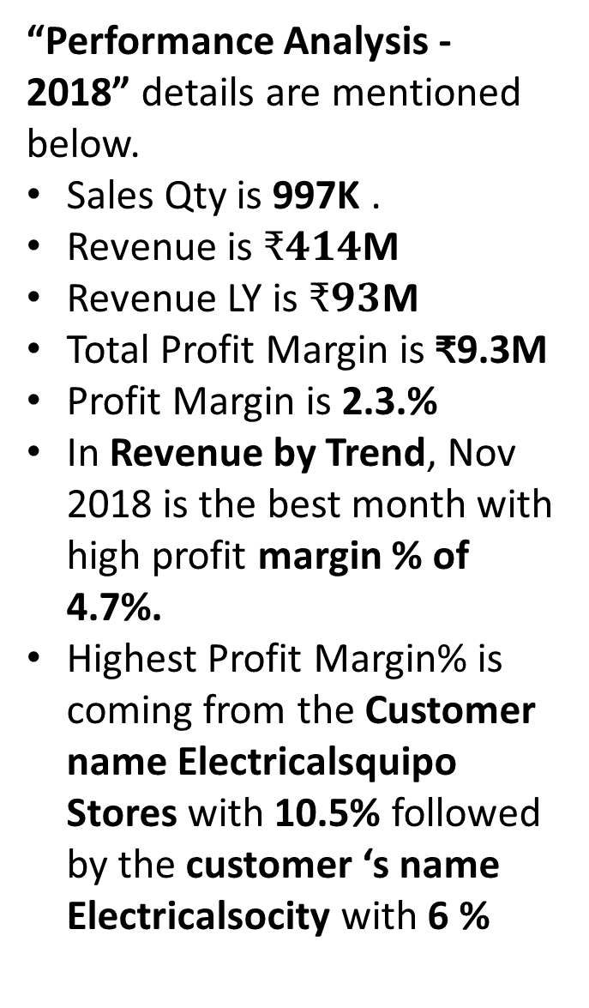
6
Power BI – Sales Performance Analysis
Performance Analysis – Year 2018
“Performance Analysis - 2018” details are mentioned below.
Sales Qty is 997K .
Revenue is $₹414$M
Revenue LY is $₹93$M
Total Profit Margin is ₹9.3M
Profit Margin is 2.3.%
In Revenue by Trend, Nov 2018 is the best month with high profit margin % of 4.7%.
Highest Profit Margin% is coming from the Customer name Electricalsquipo Stores with 10.5% followed by the customer ‘s name Electricalsocity with 6 %
6

Slide 24
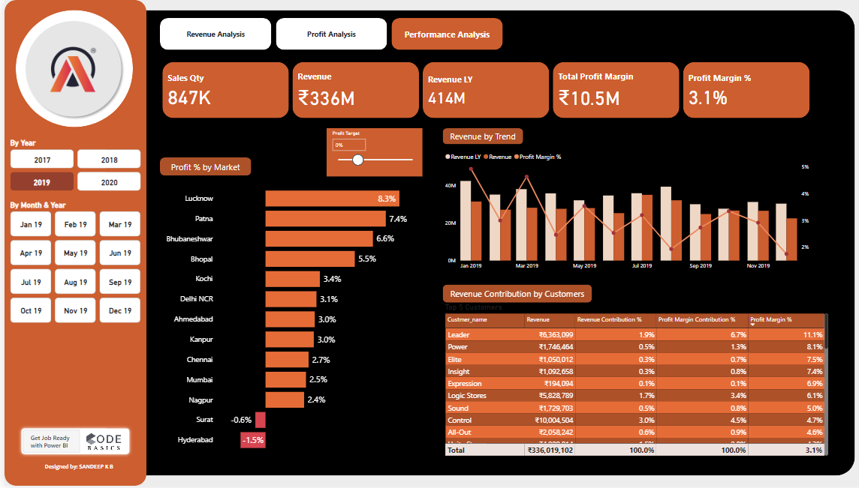
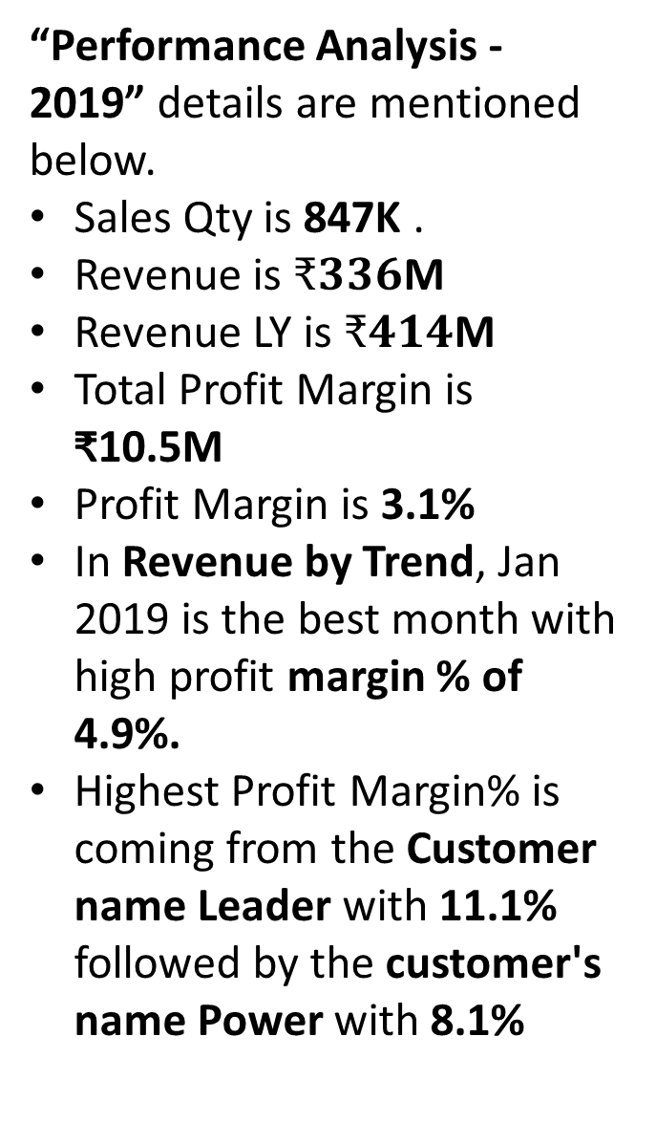
6
Power BI – Sales Performance Analysis
Performance Analysis – Year 2019
“Performance Analysis - 2019” details are mentioned below.
Sales Qty is 847K .
Revenue is $₹336$M
Revenue LY is $₹414$M
Total Profit Margin is ₹10.5M
Profit Margin is 3.1%
In Revenue by Trend, Jan 2019 is the best month with high profit margin % of 4.9%.
Highest Profit Margin% is coming from the Customer name Leader with 11.1% followed by the customer's name Power with 8.1%
6

Slide 25
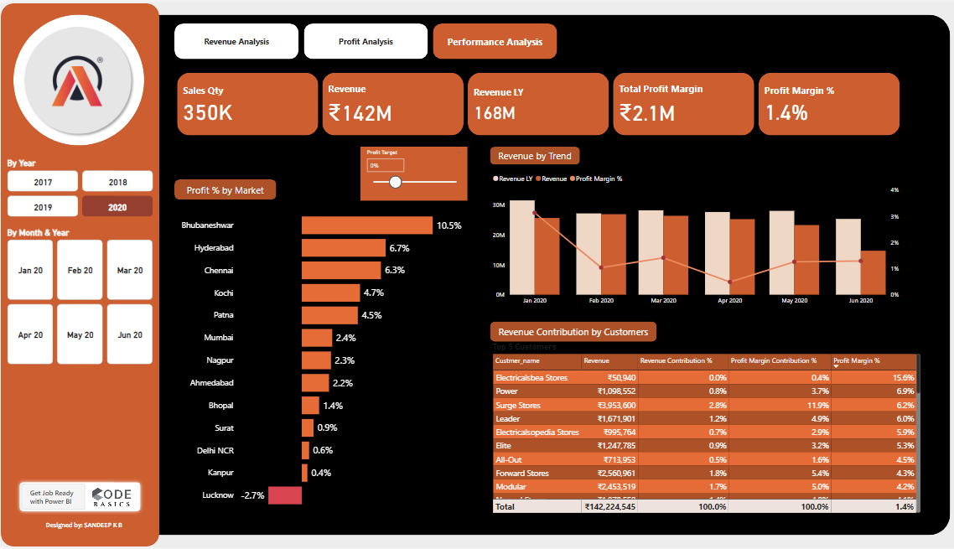
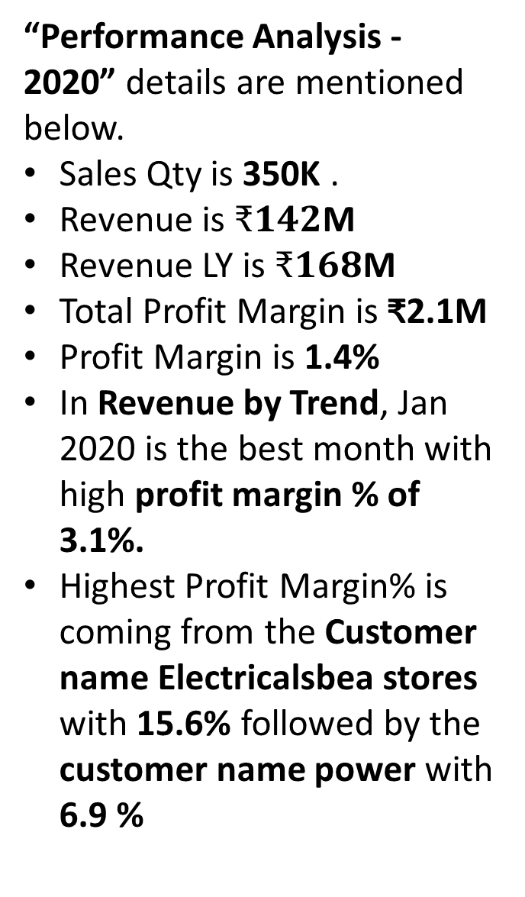
6
Power BI – Sales Performance Analysis
Performance Analysis – Year 2020
“Performance Analysis - 2020” details are mentioned below.
Sales Qty is 350K .
Revenue is $₹142$M
Revenue LY is $₹168$M
Total Profit Margin is ₹2.1M
Profit Margin is 1.4%
In Revenue by Trend, Jan 2020 is the best month with high profit margin % of 3.1%.
Highest Profit Margin% is coming from the Customer name Electricalsbea stores with 15.6% followed by the customer name power with 6.9 %
6

Slide 26
7
Insights Summary - Revenue
Revenue Insights Summary:
Top Performers:
Region: Delhi NCR led in revenue each year.
Customer: Electrical Sara Stores consistently topped sales.
Revenue Peaks:
Highest revenue months were November 2017, January 2018, July 2019, and February 2020.
Notable Issues:
Data errors indicated by top product listed as "(Blank)" every year.
Trends:
Revenue and sales peaked in 2018, declined thereafter.
Profit margins varied, highest in 2019 (3.1%), lowest in 2020 (1.4%).
7

Slide 27
7
Profit Insights Summary
Profit Insights Summary:
Total Profit Margin
2017: ₹2.8M (Profit Margin: 3.0%)
2018: ₹9.3M (Profit Margin: 2.3%)
2019: ₹10.5M (Profit Margin: 3.1%)
2020: ₹2.1M (Profit Margin: 1.4%)
Top Market by Revenue Contribution (RC%)
2017: Delhi NCR (53.3%)
2018: Delhi NCR (53.4%)
2019: Delhi NCR (51.0%)
2020: Delhi NCR (54.7%)
Top Market by Profit Percentage
2017: Lucknow (9.1% Profit, 0.9% RC)
2018: Surat (8% Profit, 0.4% RC)
2019: Lucknow (8.3% Profit, 0.3% RC)
2020: Bhubaneshwar (10.5% Profit, 0.1% RC)
Worst Performing Market by Profit Percentage
2017: Bhubaneshwar (-6.4% Loss)
2018: Bengaluru (-20.8% Loss)
2019: Hyderabad (-1.5% Loss)
2020: Lucknow (-2.7% Loss)
Top Customer by Revenue Contribution
2017: Electrical Sara Stores (38.8% RC)
2018: Electrical Sara Stores (41.8% RC)
2019: Electrical Sara Stores (41.2% RC)
2020: Electrical Sara Stores (46.2% RC)
Revenue Trends (Notable Highs)
2018: January - Highest revenue month with ₹42M
Summary:
Over the four years, the sales quantity and revenue saw fluctuations, with a notable peak in 2018.
Profit margins varied, peaking in 2019 at 3.1%.
Delhi NCR consistently contributed the most to revenue each year.
The top market by profit percentage varied, with different cities taking the lead each year.
Electrical Sara Stores remained the top customer by revenue contribution throughout the period.
Revenue trends highlighted January 2018 as a significant month for revenue generation.
7

Slide 28
7
Performance Insights Summary
Key Performance Insights Summary:
Revenue and Sales Trends:
Peak Performance: 2018 was the peak year with the highest revenue of ₹414M and sales quantity of 997K units.
Decline in 2020: There was a significant drop in both revenue and sales quantity in 2020, indicating possible market or operational challenges.
Profit Margin Trends:
Fluctuations: The profit margin percentage varied across the years, with 2019 having the highest overall profit margin of 3.1%, while 2020 saw a sharp decline to 1.4%.
Best Months: The best months for profit margins shifted each year, with December (2017), November (2018), and January (2019 and 2020) being notable.
Customer Contributions:
Top Customers: Different customers led in profit margins each year, with Sage (2017), Electricalsquipo Stores (2018), Leader (2019), and Electricalsbea Stores (2020) being top contributors.
Consistent Performers: The customer named Leader appeared in the top customer list twice, indicating a relatively consistent contribution.
Year-over-Year Comparisons:
Revenue Growth and Decline: 2018 saw a significant revenue growth compared to 2017 (from ₹93M to ₹414M), but this was followed by a decline in 2019 and 2020.
Profit Margins: Despite revenue changes, profit margins did not consistently correlate with revenue, suggesting varying cost structures or pricing strategies.
7

Slide 29
7
Insights Summary - Conclusion
Conclusion:
Revenue and Sales Trends:
2018 Peak: Revenue peaked at ₹414M and sales at 997K units.
Decline: Revenue and sales dropped in 2019 and further in 2020.
Profit Margins:
Highest in 2019: Overall margin was 3.1%.
Lowest in 2020: Margin dropped to 1.4%.
Monthly Bests: Best months varied yearly, indicating seasonal or market influences.
Customer Contributions:
Top Customers: Different leading customers each year.
Consistent Performer: Leader appeared in top customer list for two years.
Year-over-Year Comparisons:
2018 Growth: Significant revenue increase from ₹93M (2017) to ₹414M.
Subsequent Decline: Revenue fell after 2018.
Strategic Insights:
Analyze 2018: Understand drivers' of 2018 success.
Address Declines: Identify causes of 2019 and 2020 declines.
Customer Focus: Strengthen ties with consistently high-performing customers.
7

Slide 30




THANK YOU
Mr. DHAVAL PATEL
Mr. HEMANAND VADIVEL

